Slide 1

An exploration of bias on cyberbullying classifiers
Yiyang, Amaan, Tori
Notes:
Hi we’re YAT and our project today is all about cyberbullying- what classifies a tweet as abusive, and how explainable AI can give more insight into what makes these classifiers reach their decision

Slide 2

Introduction
Twitter’s auto moderation?
Biases in classifiers
Explainable AI using LIME
Notes:
Twitter has the option for you to flag a tweet as abusive, but Twitter says more than 50 percent of tweets identified as abusive are now being flagged by its automated moderation tools first and taken down before a user reports them. This means Twitter uses machine learning to classify a tweet as bullying or not.
We tried to replicate this, using different classifiers and used explainable AI to explain what biases arise in a tweet, i.e what significant words play a role in the classification of a tweet.

Slide 3
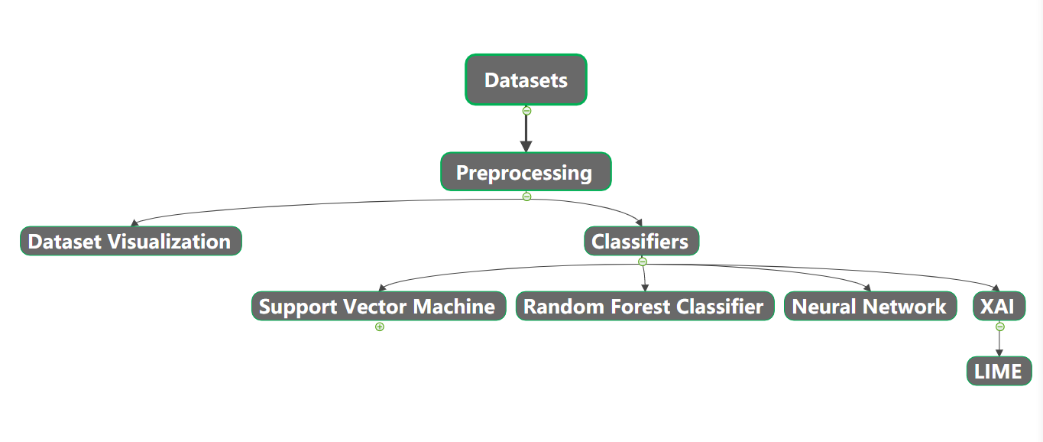
Overview of our project

Slide 4
Dataset & Preprocessing
Mendeley’s cyberbullying datasets: https://data.mendeley.com/datasets/jf4pzyvnpj/1
Hate speech, aggression, insults and toxicity
Filtering @’s, #’s, used nltk’s TweetTokenizer

Slide 5
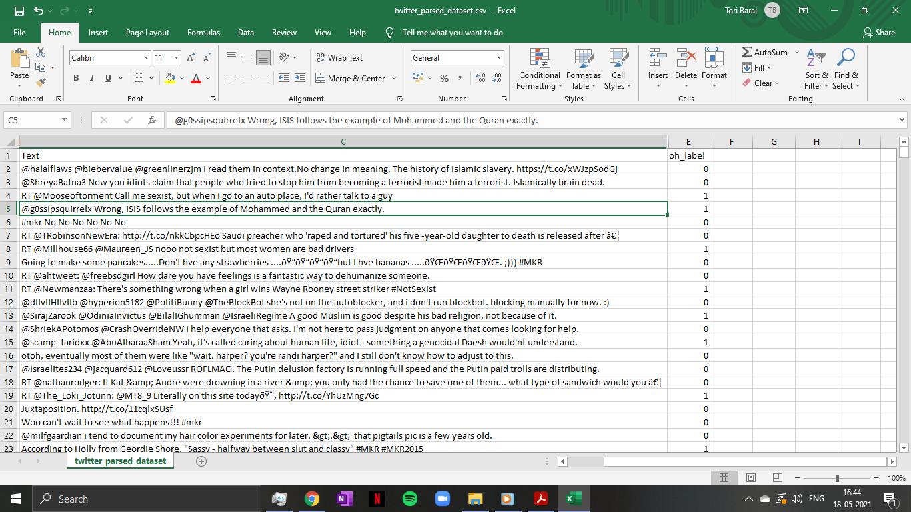

Slide 6
Classification results from Models
Best Performing: SVM
Limited size of dataset
Surprising result; the non-standardly scaled dataset performed best across the majority of classifiers
Approach we found during research was that keeping stopwords within the text was desirable, conflicted with our own findings.
Notes:
used accuracy as our metric because for datasets without a class imbalance, performed under sampling,
beat MLP and forest ensemble variations we tried -> think due to limited size of dataset ;
non standardly scaled data performed better across the board ->

Slide 7
XAI in General
What is X-AI:
Transparency and Post-hoc
Techniques common in X-AI:
Local Explanations
Visual explanation
Feature relevance explanation and many more
Notes:
Transparency can be understood through 3 ideas:
How inherently understandable - millions of dimensions isn’t understandable.
Simulatibillity -> ability for a human to reason about model as a whole, complexity is the leading identifier here -> single perceptron neural Network falls within
Decomposability -> ability to explain the separate parts of the model [input, parameters, calculations] - most models run on high dimensional word embeddings
Algorithmic transparency -> humans can model the input to output process; Linear Regression possible but not in Deep architectures where we approximate the loss rather than observe it.

Slide 8
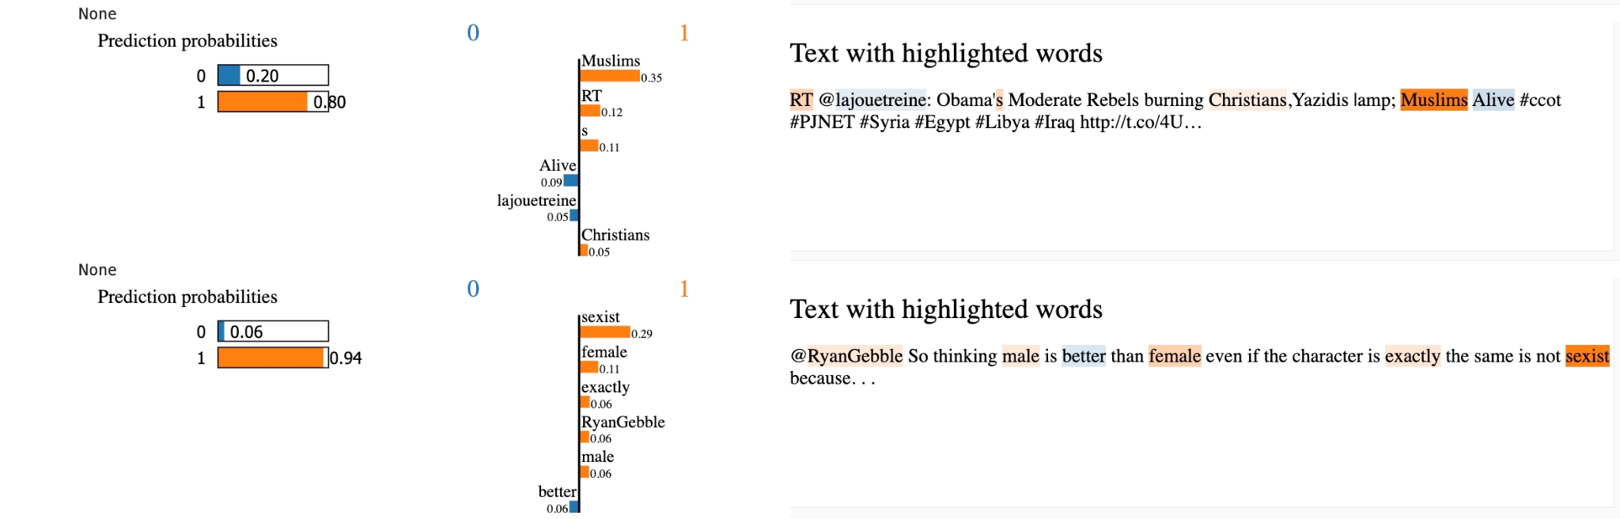
XAI in our project
Local Interpretable Model-Agnostic Explanations (LIME)
Explains classifiers
Predicts individual tokens for text classifiers or classifiers that act on tables

Slide 9
Improvements and struggles
Integrate unsupervised learning
Switch library from sklearn to more easily explore other visualisation libraries/neural networks
Filtering out languages other than English
Separate techniques for short tweets
Collaborative working on Github, had setbacks due to difficult to resolve git conflicts
Notes:
#we have tried our best!!!! Show it

Slide 10

Thank you for listening!
And have a nice day!

Slide 11
Citations
https://www.theverge.com/2019/10/24/20929290/twitter-abusive-tweets-automated-removal-earnings-q3-2019
Google Images

